Slide 1
Critical Thinking & IT Concepts
Week 6 – SDLC

Slide 2
Software Engineering
Software engineering is concerned with all aspects of software production from the early stages of system specification through to maintaining the system after it has gone into use.
Software engineering is important for two reasons:
Able to produce reliable and trustworthy systems economically and quickly.
It is usually cheaper, in the long run, to use software engineering methods for software systems rather than just write the programs.
The systematic approach that is used in software engineering is sometimes called a software process.

Slide 3
Software Process/SDLC
A software process is a sequence of activities that leads to the production of a software product.
There are four fundamental activities that are common to all software processes:
Software specification, where customers and engineers define the software that is to be produced and the constraints on its operation.
Software development, where the software is designed and programmed.
Software validation, where the software is checked to ensure that it is what the customer requires.
Software evolution, where the software is modified to reflect changing customer and market requirements.

Slide 4
Software Process
Software engineering is a systematic approach to the production of software that takes into account practical cost, schedule, and dependability issues, as well as the needs of software customers and producers.
The approach depends on the organization developing the software, the type of software, and the people involved in the development process.
There are no universal software engineering methods and techniques that are suitable for all systems and all companies.

Slide 5
SDLC Phases
Analyze: Development team communicates with customers and make analysis of their requirement and analyze the system. A report of identified area of problem is made (SRS), which has details like project plan or schedule of the project, the cost estimated for developing and executing the system, target dates for each phase of delivery of system developed.
Design: Analysis is made on the design of the system that is going to be developed, such as database design, the design of the architecture chosen, functional specification design. If a well structured and analyzed design document is prepared, it would reduce the time taken in the coming steps of the software development life cycle.

Slide 6
SDLC Phases
Build: Based on the design documents prepared in earlier phase, code is written in the programming technology chosen.
Test: System developed would be tested (unit or system testing) and reports are prepared about bugs or errors in system. After this process the system again goes to development phase for correction of errors and again tested. This process continues until the system is found to be error free.
Deploy: System gets into live.

Slide 7
Waterfall Approach
- Requirements are known
- Each stage signed off before the
next one commences
- Need extensive documentation
- Perfect approach if requirements
are fully understood
Analyze
Design
Build
Test
Deploy

Slide 8
What’s Wrong with the Waterfall?
The strengths of waterfall include
Highly organized
Extremely logical
Weaknesses
Humans are involved
Requires all good ideas at the start
In reality, good ideas arise throughout the project
Waterfall documents all ideas
In reality documents are seldom read
When read, they are often misunderstood
We find that a rigid process results in mediocre products that are never better than the original idea

Slide 9
When to consider waterfall approach?
Suitable for repeatable, knowable processes
Client enforces their very formal approach on vendor
Client does not expect rapid change in the scope
Your project team is experienced with specific heavy weight approach
Rigid things that don’t change much over time

Slide 10
Disadvantages of Waterfall Approach
Classical methods of software development have many disadvantages:
Huge effort during the planning phase
Poor requirements conversion in a rapid changing environment
Quality needs to be managed actively
Fixed features but variable time and cost

Slide 11
Agile Approach
New methods – Agile Software Development
Advantages of Agile
Adaptive and responsive to change
Identifying and prioritizing high value features
Avoid the pitfalls of waterfall
Time, cost and quality are fixed but variable features
Adjust features and priority every iteration, as needed

Slide 12
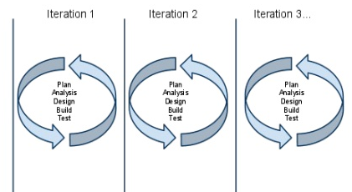
Agile Approach
Outline Analyses , Design, Plan

Slide 13
Agile Development
Tries to reflect human reality
Tries to get working software quickly rather than concentrating on planning
Use cross functional teams which can make their own decisions
Uses rapid iteration to build the product in smaller pieces

Slide 14
When to consider agile approach?
In- house projects
Projects for more flexible clients – don’t have to adjust to client’s processes.
Scope of project is rapidly changing
Team isn’t fluent with any specific project management approach

Slide 15
SCRUM
Scrum is an agile process that can be used to manage and control software and product development using iterative, incremental practices; focuses on delivering the highest business value in the shortest time.
The business sets the priorities. The teams self-manage to determine the best way to deliver the highest priority features.

Slide 16
SCRUM
Every two weeks to a month anyone can see real working software and decide to release it as is or continue to enhance for another iteration.
Product progresses in a series of month-long “sprints”.
Product is designed, coded and tested during the sprint.

Slide 17
SCRUM
A single iteration includes:
Analyses: what are we trying to accomplish
Design & Build: how will we accomplish and building the solution
Test then deploy or repeat another cycle (steps may overlap)
Plan
Plan
Plan
Plan
Review
Deploy
Build
Build
Build
Build
Test
Test
Test
Test
Review
Review
Review
Review

Slide 18
SCRUM
Scrum is an iterative approach to project development
It consists of a series of sprints, each of which is time boxed between 2-4 weeks
If the work is not complete at the end of a sprint, the sprint is never extended

Slide 19
SCRUM
At the beginning of the sprint, the team selects items they will do in the sprint
Every morning, the team meets to discuss progress and adjust to meet their schedule
At the end of the sprint, the team reviews the sprint to discover what they did right and wrong

Slide 20
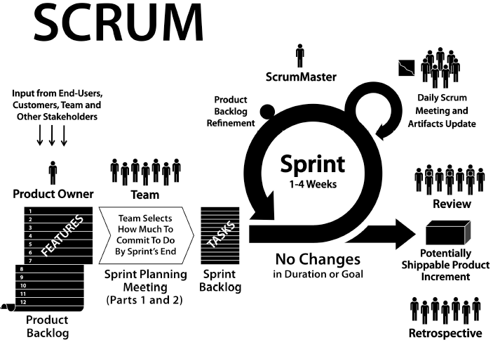

Slide 21
SCRUM Definitions
Product Backlog
This is a list of features that must be implemented
These features are prioritized so that the most important and lowest cost can be easily identified
Sprint Backlog
The list of items from the product backlog that the team has committed to build in this sprint
Sprint
The 2-4 week period in which the team works to build the items they have committed to build

Slide 22
SCRUM Personnel
Daily scrum meeting
Daily meeting to judge progress and adjust strategy
Product Owner
Responsible for prioritizing list of items
Continually re-prioritizes list to get items of highest value to the business
Only one person is the product owner and he or she is responsible for the value of the resulting product

Slide 23
SCRUM Personnel
The Team
Builds what the product owner tells them to
Is cross-functional by having people with diverse skills necessary to build the product
Is self-organizing and has a high degree of autonomy
Commits to build the items in the sprint backlog
A team consists of 7 plus or minus 2 people
A team is staffed for and devoted to the development of one particular product

Slide 24
SCRUM Personnel
Scrum Master
Helps the personnel to learn and apply scrum
Protects the team from outside interference
Educates upper management on how scrum works

